Slide 1
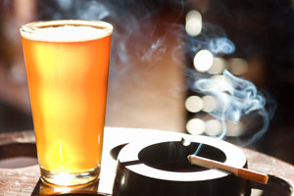


The association of smoking with drinking patterns: opportunities to reduce smoking among students
Louise Marsh, Kimberly Cousins, Andrew Gray, Kypros Kypri, Jennie Connor, and Janet Hoek
Cancer Society Social & Behavioural Research Unit (SBRU)
Te Hunga Rangahau Ārai Mate Pukupuku
25 years of social & behavioural research in cancer control

Slide 2
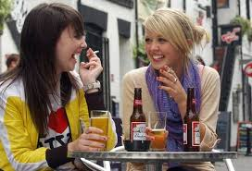
Smoking and drinking among tertiary students
Move from daily to occasional smoking
Context of smoking
Health consequences of occasional smoking
Binge drinking among students
Marketing environment for tobacco and alcohol

Slide 3

Tertiary Student Health Survey
To estimate daily and non-daily smoking among university students in NZ and examine associations with drinking patterns and socio-demographics

Slide 4
Smoking Patterns
Smoking | 2002 | 2013
Daily smoking | 10% | 3%
Occasional | 10% | 14%
Non-smoking | 80% | 83%

Slide 5
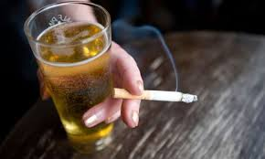
Link between smoking and drinking
Strong link between smoking and alcohol consumption among students
  Drinking more frequently
  Drinking larger volumes

Slide 6
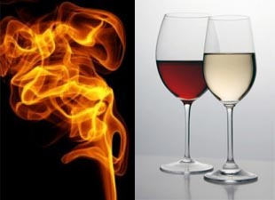
De-couple the sale of tobacco and alcohol

Slide 7
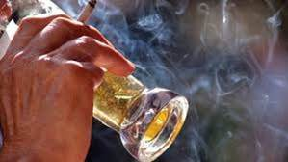
Extending smokefree areas outside bars

Slide 8

Contact details:
Louise Marsh
Cancer Society Social and Behavioural Research Unit University of Otago
Louise.marsh@otago.ac.nz

