Slide 1
Smoking in movies: How a policy loophole harms young people
Philip Gendall¹, Janet Hoek¹, Stanton Glantz²
¹University of Otago, ²University of California, San Francisco

Slide 2
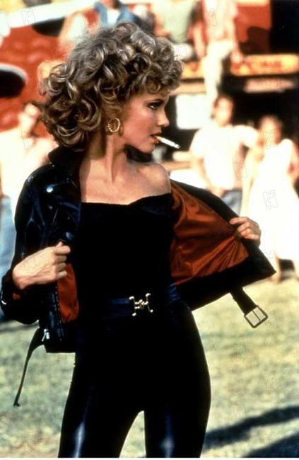
Controlling the tobacco epidemic
Current approaches constrain the 4Ps
Restrictions on mass media promotions
Mass media smokefree and denormalisation campaigns
Excise tax increases
In-store display restrictions
BUT
Important loopholes remain
Particularly product placement

Slide 3
Smoking in movies
Effects of exposure:
Exposure to smoking in movies ➔over-estimation of smoking prevalence
Reframing of smoking as normal and socially accepted
Minimisation of smoking’s risks
Causal relationship between exposure and risk of experimentation

Slide 4
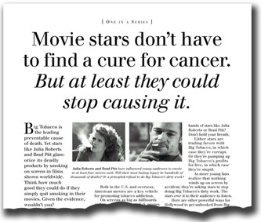
How does exposure to smoking work?
Social and vicarious learning
Promotes adoption of behaviours modelled
Young people observe environments, learn from others, and re-enact experiences
Imagery supports identity development

Slide 5
So, what happens in “dark” markets
Is exposure a problem here?
RQ1: To what extent are New Zealand adolescents and young adults exposed to smoking imagery in movies?
Can we link exposure to behaviour?
RQ2: What is the relationship between exposure to smoking in movies and smoking behaviour?
What is the attributable risk of exposure?
RQ3: How would reducing exposure to smoking in movies affect young people’s risk of smoking initiation?

Slide 6
Method: On-line survey of young adults
Sample
515 respondents aged 15-26
Procedure
Viewed 50 randomly presented movies from 423 top box office movies between 2008-2012 and one fictitious control
Smoking incidence data from Dartmouth Medical School
Instrument
Also collected demographic details and two personality attributes: sensation seeking and rebelliousness

Slide 7
Method: On-line survey of young adults

Slide 8
Results: Movie Smoking Exposure (MSE)

Slide 9
Results: Effect of MSE on smoking status
 | Odds Ratios
Predictor | Unadjusted | Adjusted
Movie Smoking Exposure per 100 smoking occurrences | 1.14 | 1.11
Social Influences
Family or friends do not smoke | 1.0 | 1.0
Family or friends smoke | 6.0 | 5.9
Age
15 to 20 | 1.0 | 1.0
21 to 26 | 2.6 | 2.5
Rebelliousness | 2.3 | 2.4

Slide 10
Attributable Risk
Reduction in risk that would be achieved if the population was entirely unexposed
AR% = I_{Total} – I_{Exposed} / I_{Total}
Meta-analysis of six previous studies:
Average AR = 37% (CI 25% - 52%)

Slide 11
Results: Attributable risk
Estimated at 49% (CI 32% - 65%)
Implications
Removing smoking from all movies would roughly halve the number of young people who smoke
Over 80% of movies tested did not have R16 or R18 (adult) ratings
Removing smoking from movies not adult rated would reduce the AR to 36% (CI 20% - 53%)

Slide 12
Discussion
Despite advertising and marketing restrictions, NZ’s film rating policy allows smoking exposure
Even after controlling for other known risk factors, a dose-response relationship with exposure remained
Other variables, especially peer and family smoking, have stronger effects
BUT, movie exposure still significant and much more amenable to policy intervention

Slide 13
Limitations
Data are cross-sectional
Cannot impute causality
Local movies not included
BUT, findings strikingly consistent with evidence from longitudinal studies
Only accounted for direct effects of smoking in movies
Indirect effects are also important
Our findings thus under-estimate the total effect of smoking in movies

Slide 14
Conclusions
Inoculate using smoke-free messages (e.g. India)
Treat smoking alongside sex, violence and offensive language
Apply R ratings
Allows producers to trade-off audience size and smoking
Creates commercial incentive to change
Would greatly reduce the attributable risk

Slide 15
Acknowledgements
Images sourced from:
UCSF Smokefree movies site: http://smokefreemovies.ucsf.edu/ourads/index.html
Movie smoking exposure data sourced from Jim Sargent MD and team at Dartmouth Medical School

